Slide 1
The internet allows on-line retailers to enhance and personalize their customer service offer
Strategies
Theme/Concept
Example
Building
Consumer Trust
Enhancing customer service by using on-line tools (e.g. secure transaction services, privacy guarantees, order fulfillment).
Amazon.com
Avon
NetGrocer
24/7 Operating Hours
24/7 Operating Hours
Allowing customers to shop / purchase at their convenience, rather than only during “opening hours”
All sites
Order
Management / Delivery Tracking
Allowing customers to view merchandise in-stock availability and delivery status directly (and in real time), improving their purchase decisions, and ultimately improving customer satisfaction.
Lands End
CDNow
OfficeMax
Micro Warehouse
Returns Processing
Providing for multi-channel returns and and using other appropriate techniques to make the returns process as seamless as possible
Spiegel
Eddie Bauer
Communication
Fostering customer communication (business-to-consumer and consumer-to-consumer) in a one-to-one (and potentially real-time) environment. This will generate valuable customer information that ultimately improve product / service offer
CDNow
dELiA*s
1-800-HOTELS
Credit Access/ Credit Card Applications
Offering instant approvals for on-line credit applications to improve customer acquisition, provide customers greater payment flexibility, and establish a platform for ongoing communication / data collection
American Eagle Outfitters
Spiegel

Slide 2
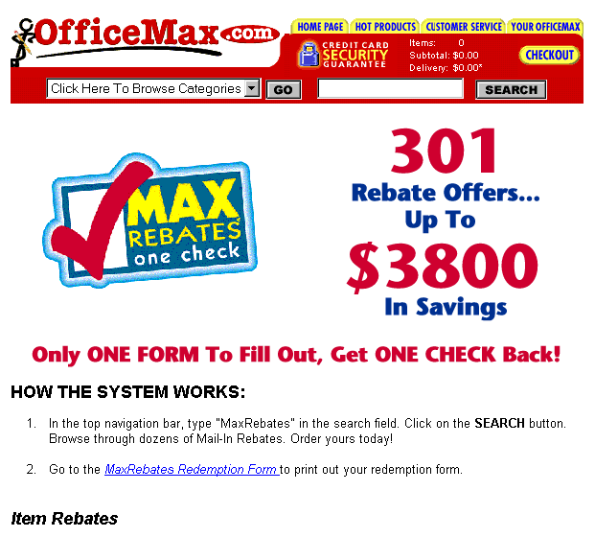
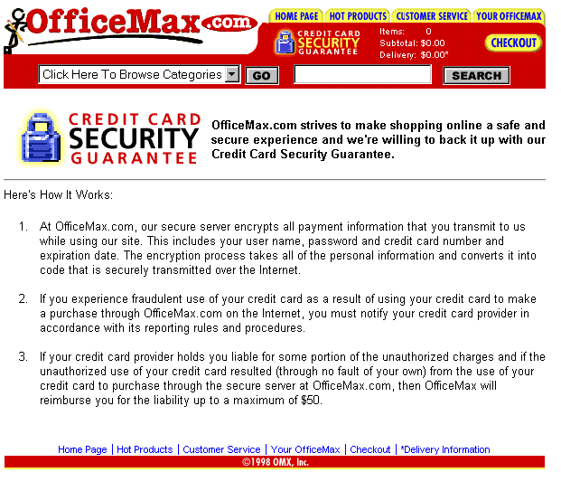
E-Biz Opportunity: Enhancing Customer Service; Building Customer Trust
Website example: http://www.officemax.com
URL:http://www.officemax.com/FreeDelivery/creditCardSecure.html?sessionID=UZ87F6HJC&&user_id=-1&user_type=27243&order_id=-1"
Secure server icon on every page
Clearly written security policies and guarantees.

Slide 3
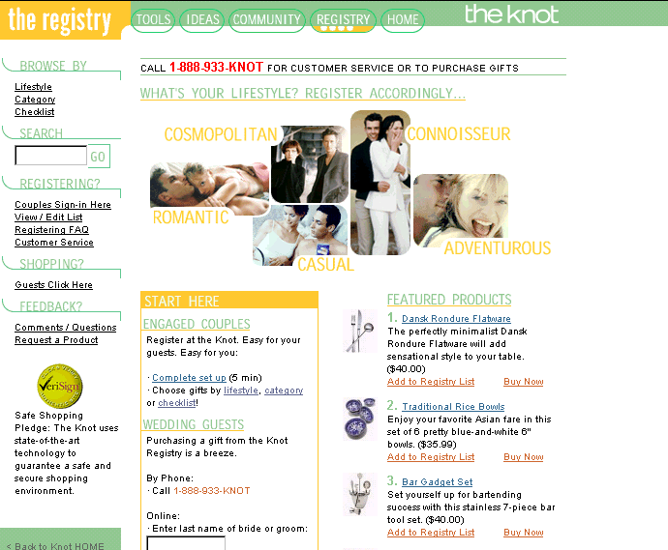
E-Biz Opportunity: Enhancing Customer Service; Building Customer Trust
Website example: http://www.theknot.com
URL: http://www7.theknot.com/registry.html
VeriSign icon shows that the site is secure.

Slide 4
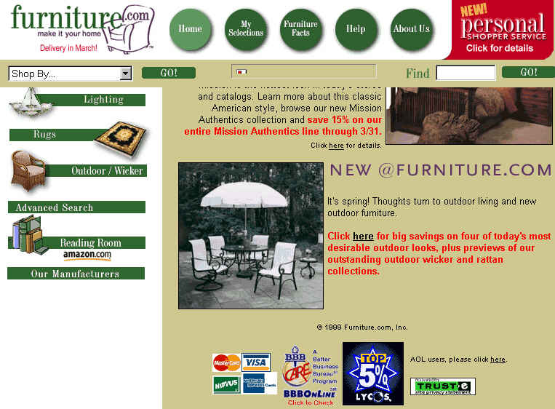
E-Biz Opportunity:Enhancing Customer Service; Building Customer Trust
Website example: www.furniture.com
URL:http://www.furniture.com/
TrustE icon shows that site is secure.

Slide 5
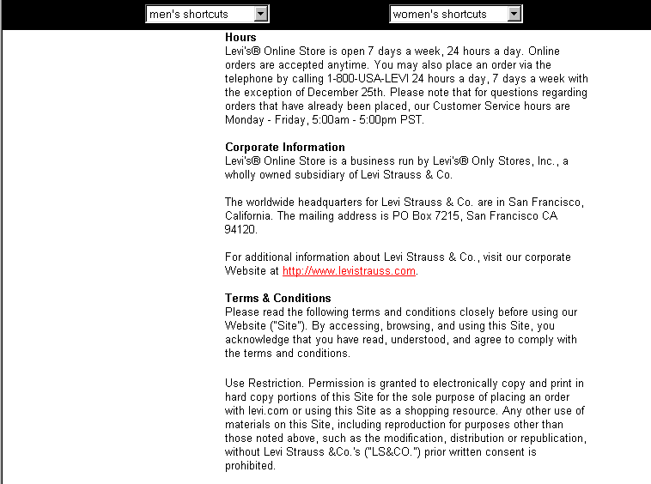
E-Biz Opportunity:Enhancing Customer Service; 24/7 Operating Hours
Website example: www.levi.com
URL: http://store.us.levi.com/store/home.asp
24/7 Operating Hours clearly stated

Slide 6
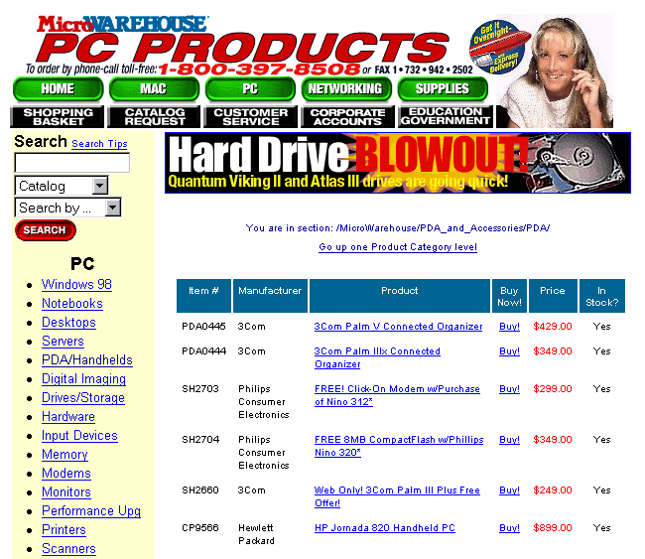
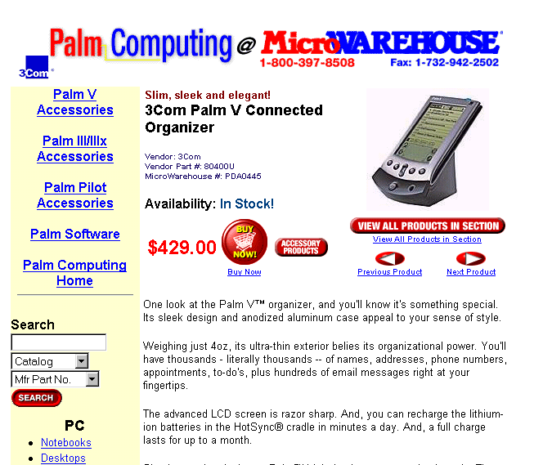
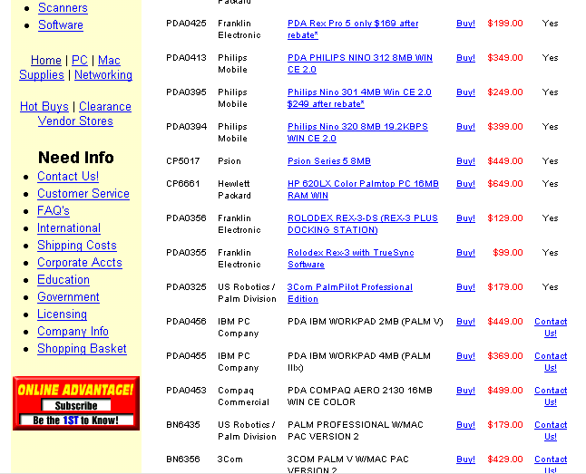
E-Biz Opportunity: Enhancing Customer Service; Order Mgmt/ Delivery Tracking
Website example: www.microwarehouse.com
URL:http://product.warehouse.com/search/BIN/SEARCHINTERFACE.DLL?OrderBy=3&num_rows=25&value=pcpda&result_template=pdahandheld.tem
In Stock Status
Product availability is clearly stated.
Customers can easily see that this product is not in stock and s/he will need to contact Microwarehouse for availability.

Slide 7
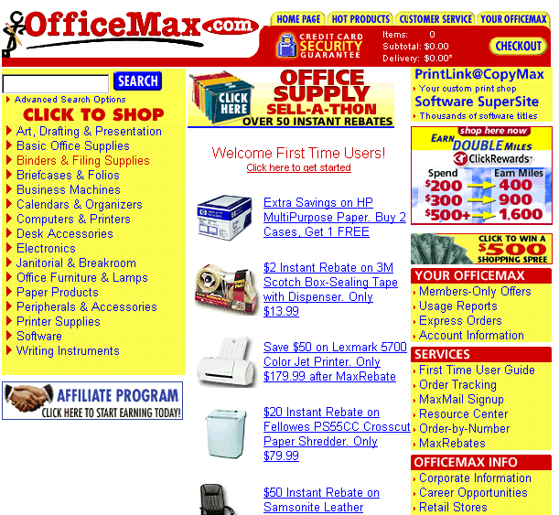
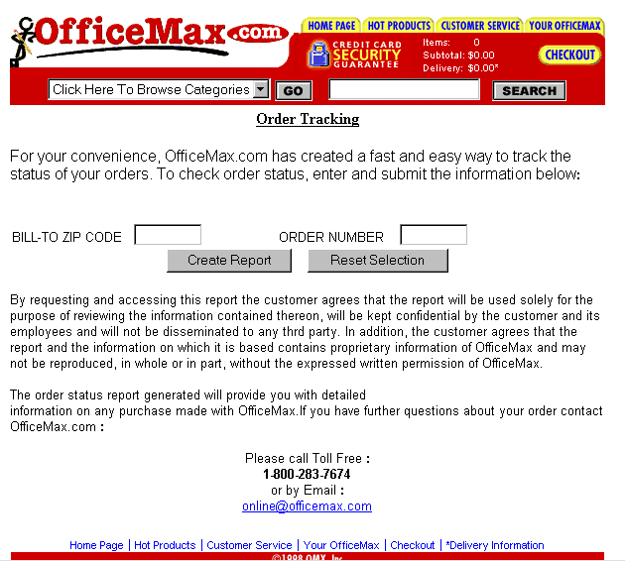
E-Biz Opportunity: Enhancing Customer Service; Order Mgmt/ Delivery Tracking
Website example: http://www.officemax.com
URL: http://www.officemax.com/FreeDelivery/ordStat.html?sessionID=UZ87F6HJC&
Order Number entry
Zip Code entry
Reset button
Order Tracking clearly stated on navigation bar
Create Status report

Slide 8
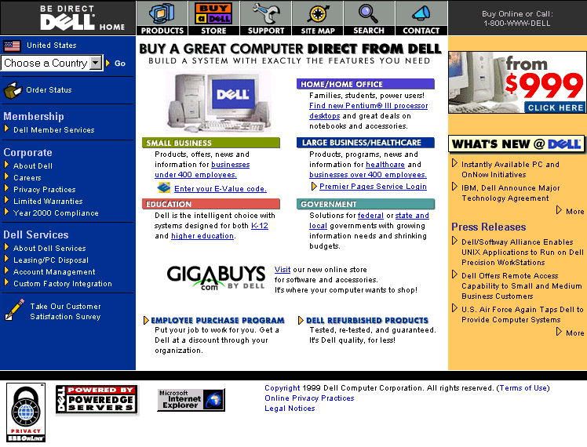
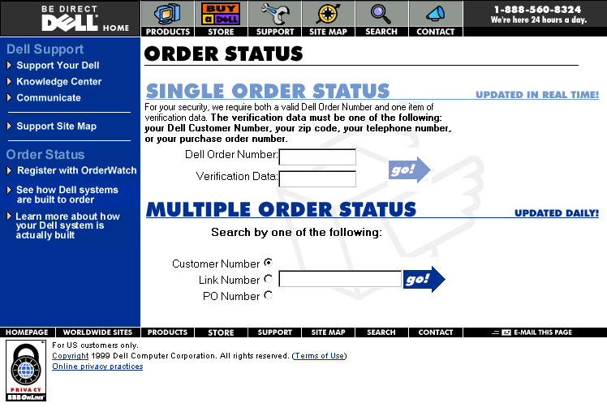
E-Biz Opportunity: Enhancing Customer Service; Order Mgmt/ Delivery Tracking
Website example: www.dell.com
URL:http://support.dell.com/ordstat/
Clear order status icon on navigation bar.
Single Order Status
When Updated - Real time information
Multiple Order Status

Slide 9
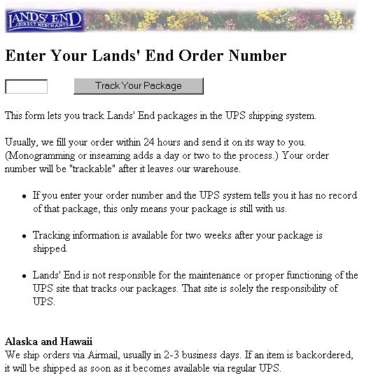
E-Biz Opportunity: Enhancing Customer Service; Order Mgmt/ Delivery Tracking
Website example: www.landsend.com
URL: http://www.landsend.com/spawn.cgi?NODEORDER1198&GRAPHIC&ZEROPAGE&0921090629226
Clear button get order tracked.
Enter Order Number

Slide 10
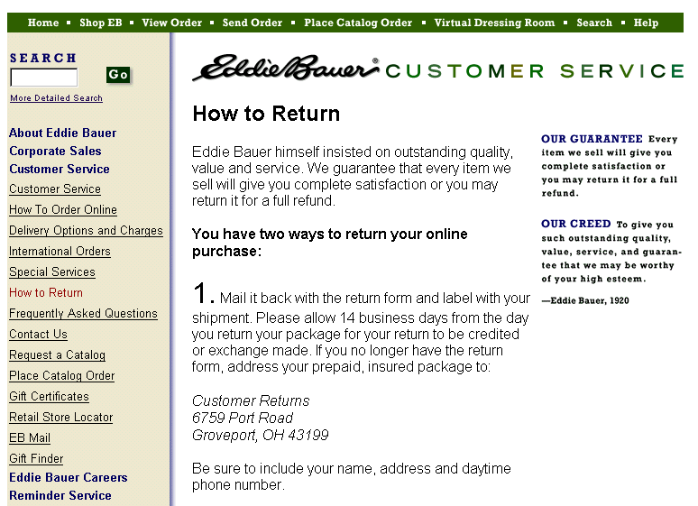
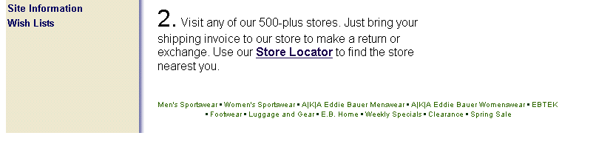
E-Biz Opportunity: Enhancing Customer Service; Returns Processing
Website example: www.eddiebauer.com
URL: http://www.eddiebauer.com/atyourservice/frame_returnpolicies.asp?L1ID=9&L2ID=91&LineID=
Eddie Bauer’s guarantee
Mail back with supplied return label.
How to return on navigation bar
Return to store option with Store Locator hot linked.

Slide 11
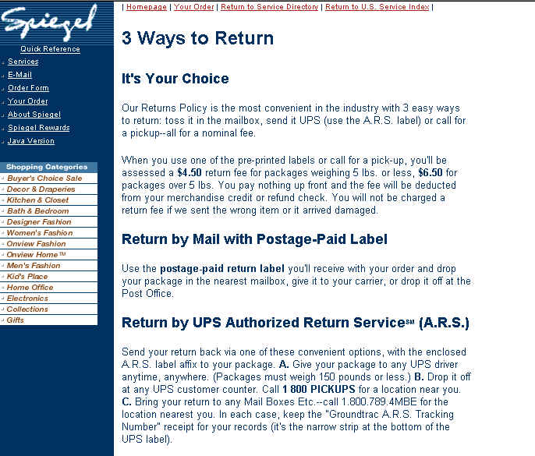
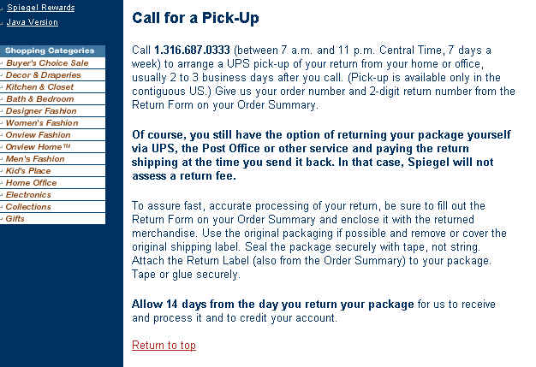
E-Biz Opportunity: Enhancing Customer Service; Returns Processing
Website example: www.spiegel.com
URL:http://www.spiegel.com/spiegel/shopping/spiegel/index.asp?sessionid=JCVJDN0GUGS12KAV0022B1KJJCR5EHCS
Three ways to return
Mail with Postage-Paid label
Call for pick-up
UPS Authorized Return Service

Slide 12
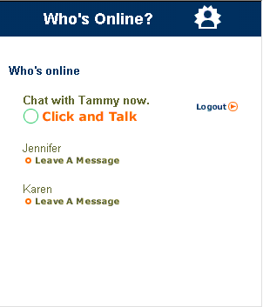
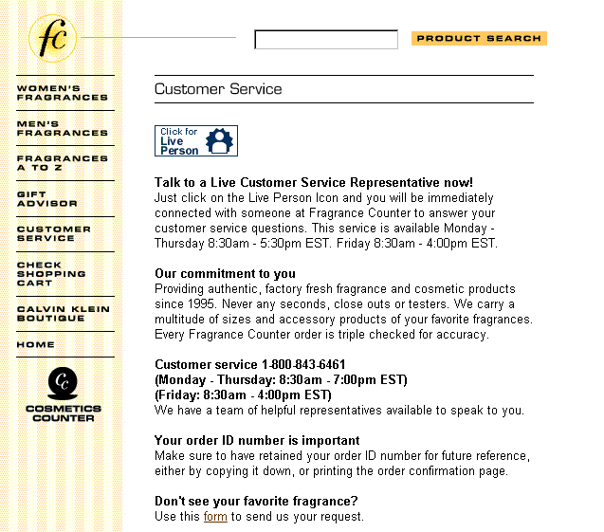
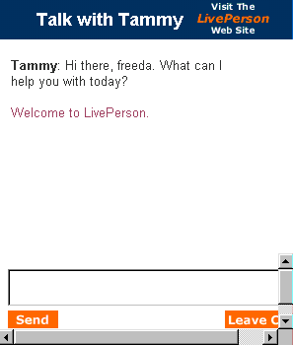
E-Biz Opportunity: Enhancing Customer Service; Communication
Website example: www.fragrancecounter.com
URL:http://www.fragrancecounter.com/customer.jtmpl?borschtid=209.143.245.226:80:32242915540821219705
New pop-up window shows who is online and allows the consumer to “click and talk” or leave a message.
Live Person Icon
States the hours when the customer can talk to a live customer service representative.
Place to submit comment
Send button

Slide 13
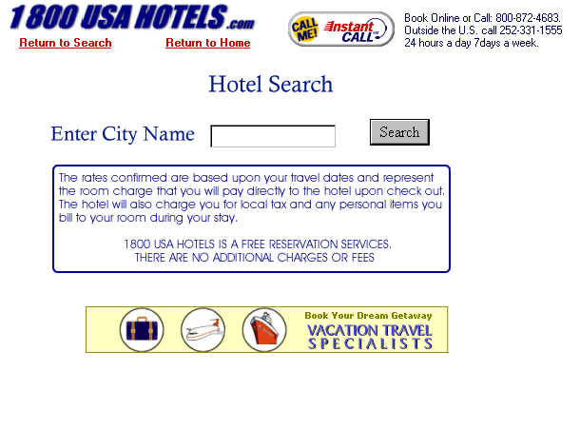
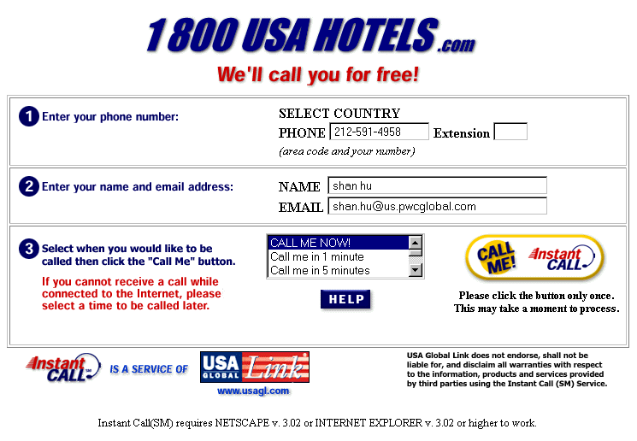
E-Biz Opportunity:Enhancing Customer Service; Communication
Website example: www.1800usahotels.com
URL: http://www.1800usahotels.com/engine/index.htm
Instant Call Icon
Enter phone number
Customer can select the time when s/he would like to receive the call.

Slide 14
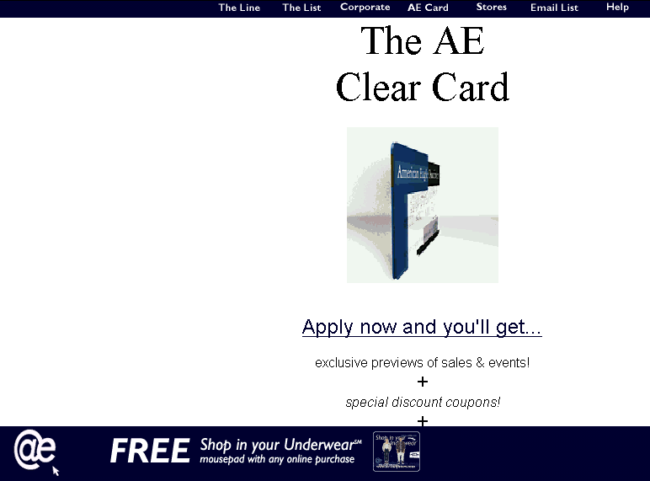
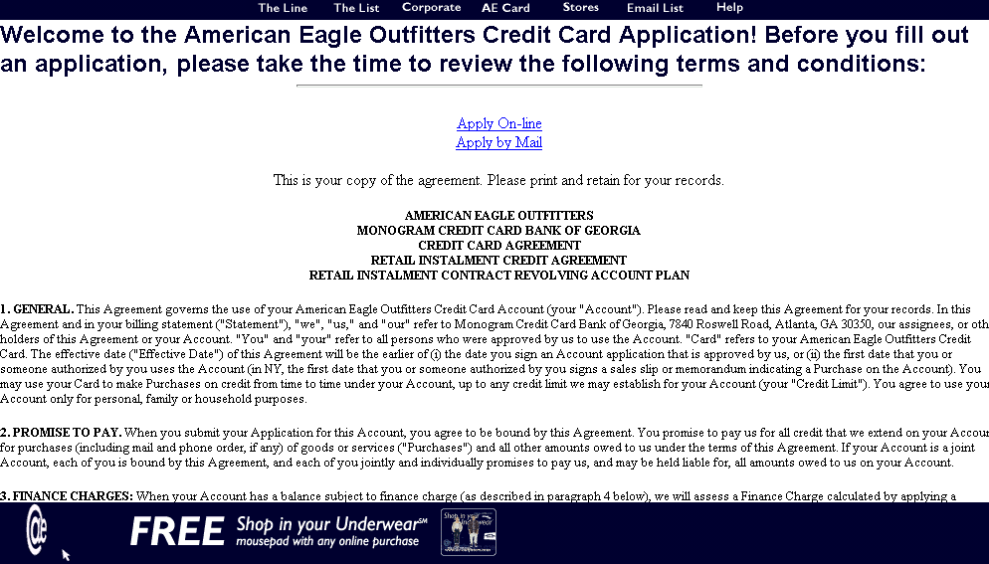
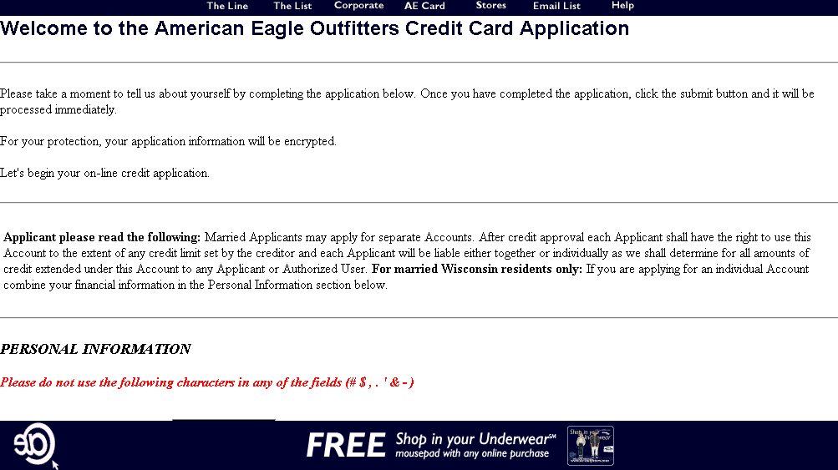
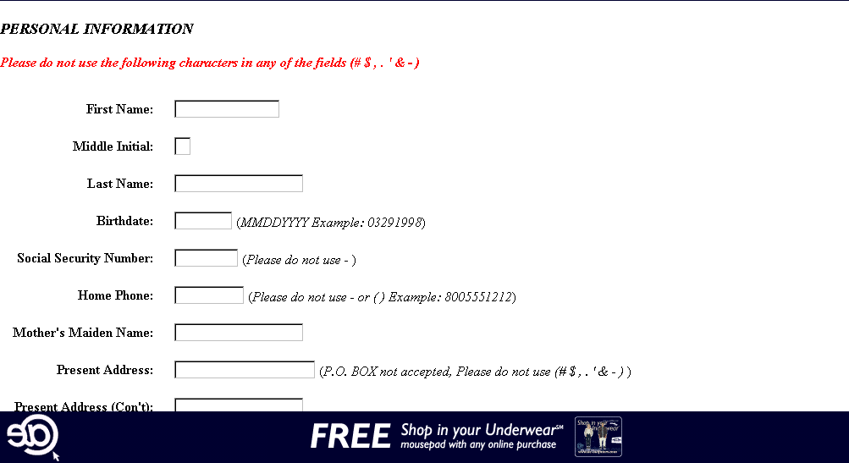
E-Biz Opportunity: Enhancing Customer Service; Credit Access/ Credit Card Application Website example: www.ae-outfitters.com
URL:http://www.ae-outfitters.com/crd_app/
AE Card on navigation bar of every page
Link to card application
Either online or offline application
Actual application

Slide 15
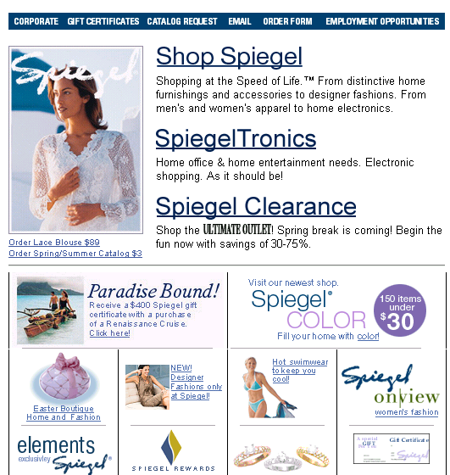
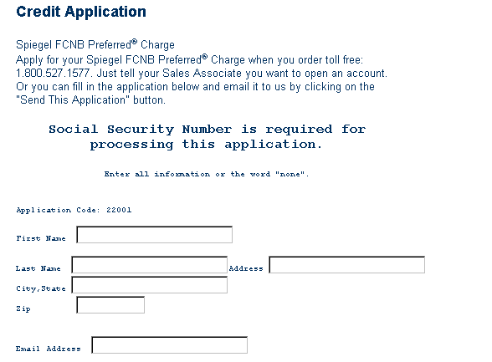
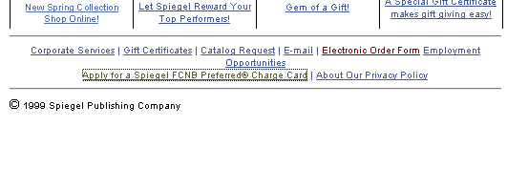
E-Biz Opportunity:Enhancing Customer Service; Credit Access/ Credit Card Application
Website example: www.spiegel.com
URL:https://secure.spiegel.com/spiegel/service/our_service/fcnb.asp?sessionid=H9E6AGVTTPSH2PNK002JB2228RFANR9Q#credit
New window displays application
Credit card application link

